Slide 1

Artificial photosynthesis for solar fuels
Stenbjörn Styring
Uppsala university

Slide 2
































Swedish Consortium for Artificial Photosynthesis
1994-
Sw. Energy agency, Knut and Alice Wallenberg Foundation; EU; VR

Slide 3
The global concept
Global energy use
Nuclear Biomass
Hydro others.....
Fossil
2011; ca 17 TW years
80%
0
10
20
30
40
TW
Notes:
3

Slide 4
Local vs. global concept
Energy supply 2008, Sweden:
Hydro
Biomass
Fossil
Nuclear
33 32 12 23 % of total
Notes:
4

Slide 5
Local vs. global concept
Energy supply 2008, Sweden:
Hydro
Biomass
Fossil
Nuclear
33 32 12 23 % of total
Energy supply 2008; Germany
Fossil
82 11 7 % of total
Notes:
5

Slide 6
The global concept
Fossil
2050
Fossil
2011: 17 TW
80%
0
10
20
30
40
TW
Notes:
6

Slide 7
The global concept
Note! This comes from people that don´t use energy
today. They can not solve this by saving energy!!!
Fossil
2050
Fossil
2011: 17 TW
80%
0
10
20
30
40
TW
Notes:
7

Slide 8
Renewable technologies (Sims et al, IPCC 2007) Electricity
Technologically mature with markets hydroelectric; geothermal;
in at least some countries woody biomass; onshore wind
landfill gas; bioethanol; silicon
solar cells.....
Technologically mature with small, new solid waste energy in towns;
markets in few countries biodiesel; offshore wind; heat
concentrating solar dishes...
Under technological development thin film PV; tidal change; wave
demonstration plants, upcoming biomass gasification; pyro-
lysis; bioethanol from ligno-
cellulose; thermal towers.......
Many give electricity

Slide 9
Everything is not electricity
Total production
Fossil
2011; ca 17 TW years
80%
10
TW
20
Notes:
9

Slide 10
Everything is not electricity
Final consumtion
Electricity 17%
Total production
Fossil
80%
10
TW
20
Notes:
10

Slide 11
Everything is not electricity
Final consumtion
Electricity 17%
The rest, 83% is used as fuel for many things
Total production
Fossil
80%
10
TW
20
Notes:
11

Slide 12
Critical insights
Electricity is an energy carrier. It is used to carry a minor part of the energy in the world.
Notes:
12

Slide 13
Critical insights
Electricity is an energy carrier. It is used to carry a minor part of the energy in the world.
2. Biomass is limited on a global scale. Although
important in many regions, there is not enough
to replace fossile fuels.
Notes:
13

Slide 14
Renewable technologies Biomass derived
Technologically mature with markets hydroelectric; geothermal;
in at least some countries woody biomass; onshore wind
landfill gas; bioethanol; silicon
solar cells.....
Technologically mature with small, new solid waste energy in towns;
markets in few countries biodiesel; offshore wind; heat
concentrating solar dishes...
Under technological development thin film PV; tidal change; wave
demonstration plants, upcoming biomass gasification; pyro-
lysis; bioethanol from ligno-
cellulose; thermal towers.......
Research stage
Many give electricity.
All fuel technologies are based on biomass

Slide 15
Critical insights
Electricity is an energy carrier. It is used to carry a minor part of the energy in the world.
2. Biomass is limited on a global scale. Although
important in many regions, there is not enough
to replace fossile fuels.
3. Need for fuels from other renewable resources
than biomass
Notes:
15

Slide 16
Solar Energy, Options
Converted solar energy; Oil,biomass….
Solar fuel
for storage
!!
Heat;
Low temp
High temp
?
!!
!
Solar cells
Electricity
12
Notes:
16

Slide 17
The energy system – local versus global aspects; the place for solar energy; need for fuel
Various concepts for solar fuels
Our science in the Swedish Consortium for Artificial Photosynthesis

Slide 18
Sustainable methods to make solar fuels/hydrogen
Solar energy and water
Solar fuel; hydrogen or carbon based

Slide 19
Sustainable methods to make solar fuels/hydrogen
Direct methods
Solar energy and water
Solar fuel; hydrogen or carbon based
Indirect

Slide 20
Sustainable methods to make solar fuels/hydrogen
Indirect
Solar energy and water
Solar fuel; hydrogen or carbon based
Photovoltaics
Electrolysis→H₂

Slide 21
Sustainable methods to make solar fuels/hydrogen
Leads to discussions about the hydrogen society
Indirect
Solar energy and water
Solar fuel; hydrogen or carbon based
Photovoltaics
Electrolysis→H₂

Slide 22
Sustainable methods to make solar fuels/hydrogen
Indirect
Solar energy and water
Solar fuel; hydrogen or carbon based
Photovoltaics
Electrolysis→H₂
C-based fuel
From H₂ and CO₂

Slide 23
Sustainable methods to make solar fuels/hydrogen
Indirect
Solar energy and water
Solar fuel; hydrogen or carbon based
Biomass
Conversion
Pyrol.,ferm., chop wood etc

Slide 24
Sustainable methods to make solar fuels/hydrogen
Indirect
Solar energy and water
Solar fuel; hydrogen or carbon based
Photosynthesis
Biomass
Conversion

Slide 25
Sustainable methods to make solar fuels/hydrogen
Indirect
Solar energy and water
Solar fuel; hydrogen or carbon based
Photovoltaics
Electrolysis→H₂
C-based fuel
From H₂ and CO₂
Photosynthesis
Biomass
Conversion
Pyrolysis, ferment., etc

Slide 26
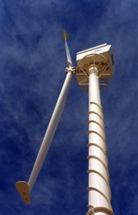
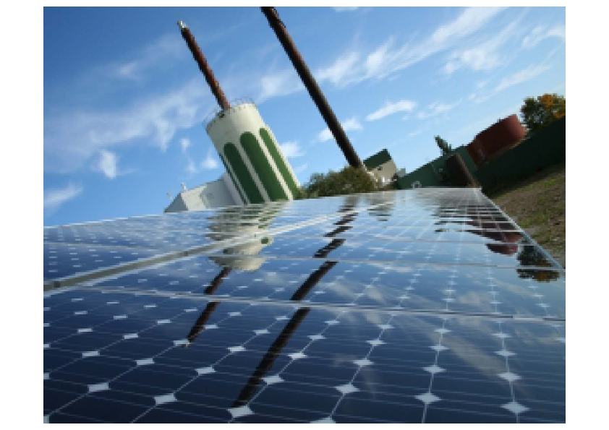
Sustainable methods to make solar fuels/hydrogen
Indirect
Electricity
Electrolysis
Solar cells in Sala/Heby
Solar energy and water
Two systems -solar cells and electrolyser
Solar fuel; hydrogen or carbon based

Slide 27
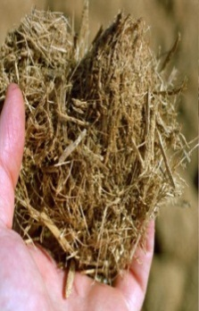
Sustainable methods to make solar fuels/hydrogen
Indirect
Solar energy and water
Solar fuel; hydrogen or carbon based
Biomass,
Trees; Waste; Grasses
Conversion
Several systems must be integrated

Slide 28
Sustainable methods to make solar fuels/hydrogen
Indirect
General - Extra systems cost
Losses in extra step(s)
Electricity
Electrolysis
Solar cells in Sala/Heby
Solar energy and water
Solar fuel; hydrogen or carbon based
Biomass,
Waste; Trees; Grasses
Conversion

Slide 29
Direct methods
Solar energy and water
Solar fuel; hydrogen or carbon based

Slide 30
Direct methods
Thermochemical cycles (CSP for H₂)
Solar energy and water
Solar fuel; hydrogen or carbon based

Slide 31
Direct methods
Thermochemical cycles (CSP for H₂)
Artificial Photosynthesis in molecular systems
Artificial Photosynthesis in materials and nanosystems
Solar energy and water
Solar fuel; hydrogen or carbon based

Slide 32
Joining in cells
H⁺ H⁺
2 H₂O
4 H⁺
D
P
P
A
e⁻
e⁻
O₂ + 4 H⁺
2 H₂
e⁻
e⁻

Slide 33
Direct methods
Thermochemical cycles (CSP for H₂)
Artificial Photosynthesis in molecular systems
Artificial Photosynthesis in materials and nanosystems
System costs might become lower in a direct process
Solar energy
Solar fuel; hydrogen or carbon based

Slide 34
Excreted
Semi-direct
Light reactions
NADPH & ATP
Photosynthesis
(compartmentalized)
Dark reactions
H₂, alcohols etc
Solar energy
Solar fuel; hydrogen or carbon based
Photobiological processes – not harvesting the organism

Slide 35

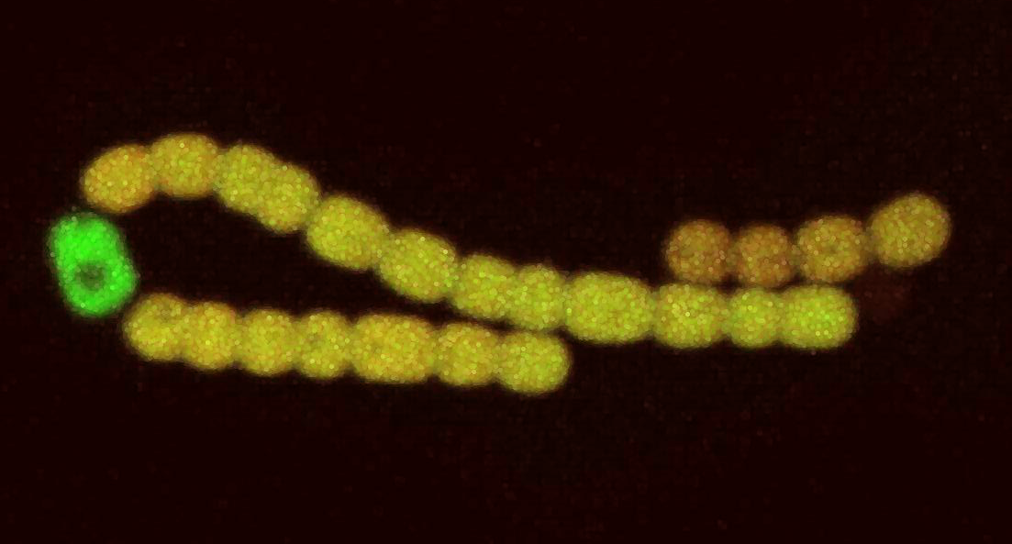
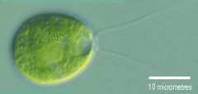
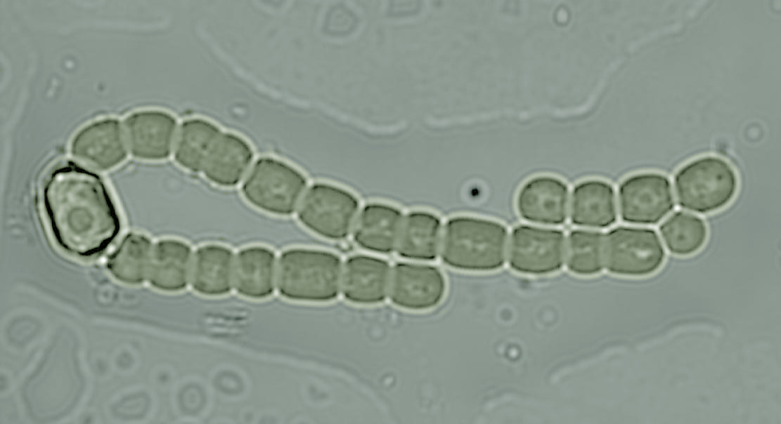
Photobiological hydrogen and fuel production using living organisms.
Vegetative cells
Green algae –Chlamydomonas
Can make hydrogen under special conditions
H₂ forming heterocyst
Cyanobacterium – Nostoc

Slide 36
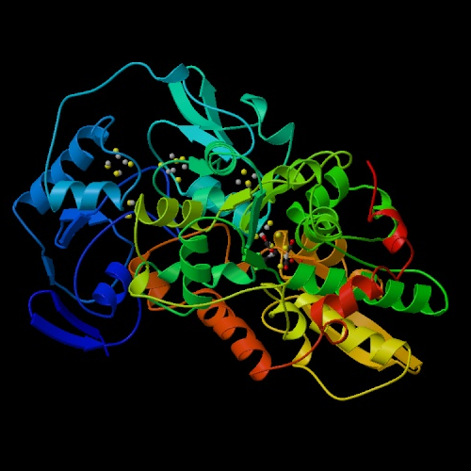
Something in between
Mixing biological and non-biological parts
H₂ses
Ru
TiO2
etc
PSII
Solar energy
Solar fuel; hydrogen or carbon based
Pt
PSI
Hybrides
Enzyme & metal catalysts

Slide 37
Direct methods
Artificial Photosynthesis in molecular systems
Artificial Photosynthesis in materials and nanosystems
Thermochemical cycles (CSP for H₂)
Semi-direct
Solar energy and water
Solar fuel; hydrogen or carbon based
Light reactions
NADPH & ATP
Photosynthesis
(compartmentalized)
Dark reactions
H₂, alcohols etc
Indirect
Photovoltaics
Electrolysis→H₂
C-based fuel
From H₂ and CO₂
Photosynthesis
Biomass
Conversion
Pyrolysis, ferment., etc

Slide 38
The energy system – local versus global aspects; the place for solar energy; need for fuel
Various concepts for solar fuels
A little on our science in the Swedish Consortium for Artificial Photosynthesis

Slide 39
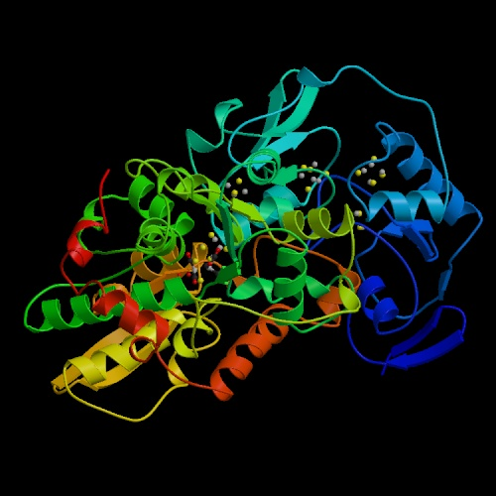
We follow two branches to Solar hydrogen, common link biochemistry, biophysics
H₂O
H₂
P

Slide 40
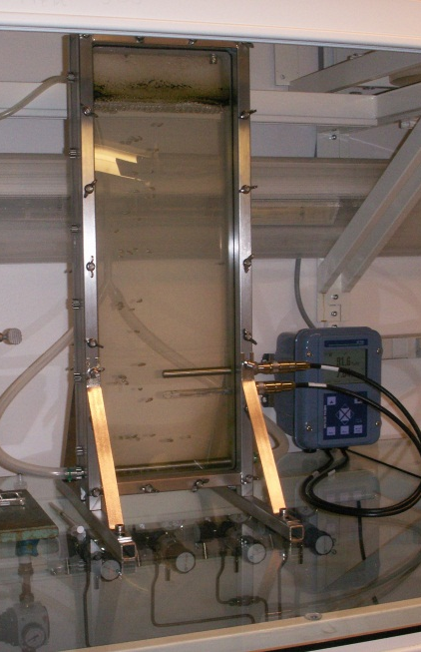
Photobiological hydrogen production in photosynthetic microorganisms
H₂O
H₂
Design of organisms
Synthetic biology, genomics, metabolomics
P

Slide 41
Artificial photosynthesis, synthetic light driven catalytic chemistry
H₂O
H₂
Fe
Ru
Fe
Mn
Mn
Design and synthesis
Spectroscopy
Co
P

Slide 42
Artificial photosynthesis:
Target – fuel from solar energy and water!
Visionary – but how?

Slide 43
Artificial photosynthesis - manmade:
Visionary – but how?
Idea for a short cut:
Mimic (copy) principles in natural enzymes
Method
Biomimetic chemistry

Slide 44
Photosystem II – the wunderkind in nature!
O₂
O₂
O₂
P
O₂
O₂
O₂
O₂
? Secret of life
Element: Mn
Atomic weight: 55
Mn
Mn
Mn
Mn
Four manganese atoms are the secret behind the splitting of water
Water

Slide 45
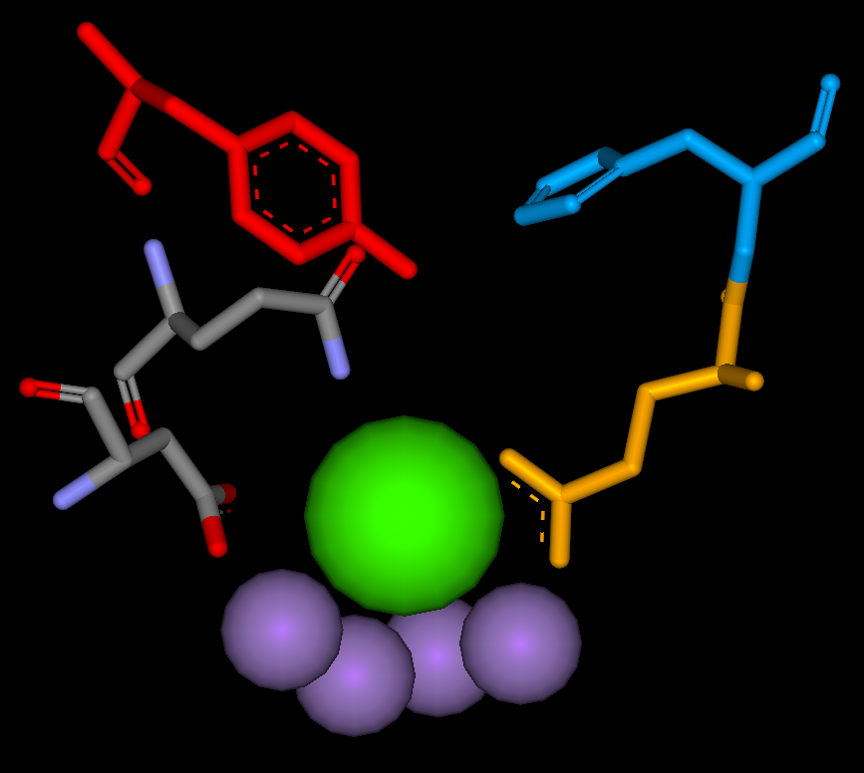
Water oxidation - the main players
Tyr_{Z} 161
His 190
Gln 165
OH
Glu 189
Asp 170
Ca
Mn
Mn
Mn
Mn

Slide 46
Supramolecular chemistry
chemical LEGO
2
H O
2
+
4H
D
Link
S
A
Link
-
e
-
2
H
+
e
2
O
+
4H
2
light
N
N
Ru
N
N
N
N
Ruthenium instead
of chlorophyll

Slide 47
Supramolecular chemistry
chemical LEGO
2
H O
2
+
4H
D
Link
S
A
Link
-
e
-
2
H
+
e
2
O
+
4H
2
light
N
Mn
Link
N
N
Ru
N
Mn
N
N
Manganese as in Photosystem II

Slide 48
Mn₂(II/II) BPMP has been connected to Ru and electron acceptors
O
O
3
+
C
H
NDI acceptor
C
8
H
1
7
8
1
7
N
N
O
O
O
O
N
N
Mn
Mn
O
O
N
N
Ru
N
N
N
N
N
N
N
Ru
N
O
N
H
N
N
E
t
O
2
C
Me
NH
EtO
C
N
N
O
N
N
2
Mn
Mn
N
O
O
O
O
N
Mw 2800
N
N
O
N
N
Mn
Mn
N
O
O
O
O
N
Me
Me

Slide 49
We seek catalysts based on abundant metals,
Mn-based systems have potential
- The Mn₄ cluster works in Photosystem II
- It is the most efficient and stable
part of PSII electron transfer
Co-based systems have potential
- We seek molecular systems
- We seek light driven systems

Slide 50
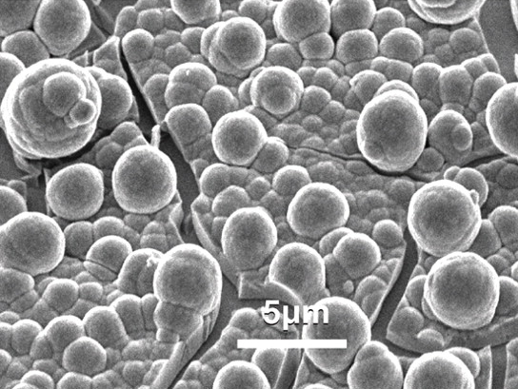
Cobalt as a water oxidation catalyst
Yin, Tan, Besson, Geletii, Musaev, Kuznetsov, Luo, Hardcastle and Hill, Science 2010, 328, 342-345
Kanan and Nocera, Science 2008, 321, 5892, 1072-1075

Slide 51
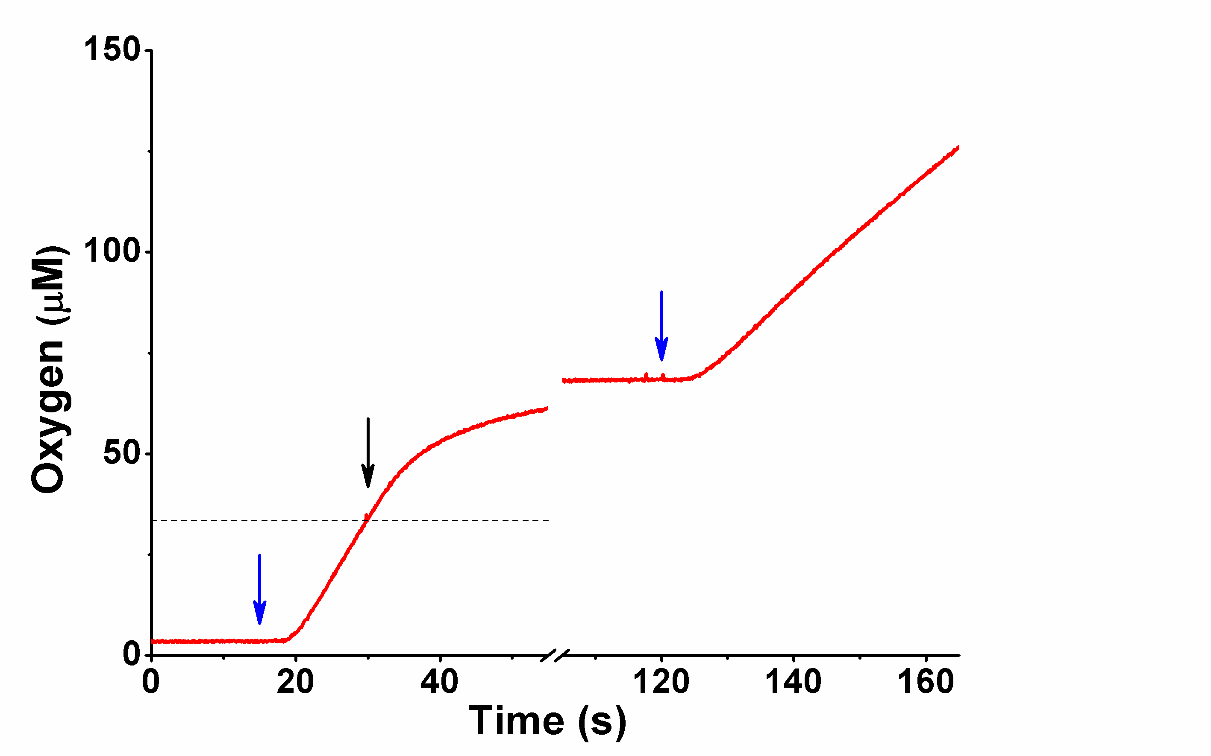
Photo-driven O₂ evolution
with a new Co-nanoparticle
Co(III) oxide
ON
50 % light
OFF
ON
1 O₂/Co
100 % light

Slide 52
Development of a Co-ligand system for use in the split cell.
1. Link the Ru-sensitizer with ligand
H₄M2P (M2P for short)
methyldiphosphonic acid
2 H₂O
Co
Ru
e-
O₂ + 4 H⁺

Slide 53
Development of a Co-ligand system for use in the split cell.
1. Link the Ru-sensitizer with ligand
H₄M2P (M2P for short)
methyldiphosphonic acid
2 H₂O
Co
Ru
e-
O₂ + 4 H⁺
Ru(M2P)
1. Synthesized and characterized.

Slide 54
Development of a Co-ligand system for use in the split cell.
Isolated Ru(M2P)Co
65 µg Ru(M2P)Co
(ca 40 µM Ru)
6 mM S₂O₈²⁻
25 mM Pi (pH 8.4)
+ P_{i} buffer
+ persulfate
+ light
Photocatalytic oxygen evolution!
Ca 1 turnover

Slide 55
Development of a Co-ligand system for use in the split cell.
Link the Ru-sensitizer with ligand
2. Can it bind Co and is it active?
H₄M2P (M2P for short)
methyldiphosphonic acid
2 H₂O
Co
Ru
e-
O₂ + 4 H⁺
Ru(M2P)
Synthesized and characterized.
Yes, it binds Co and the system is photo-catalytic!

Slide 56
Supramolecular chemistry
chemical LEGO
2
H O
2
+
4H
D
Link
S
A
Link
-
e
-
2
H
+
e
2
O
+
4H
2
Cobolt
light
Co(III)
oxide
N
Mn
Link
N
N
Ru
N
Mn
N
N

Slide 57
Supramolecular chemistry
chemical LEGO
2
H O
2
+
4H
D
Link
S
A
Link
-
e
-
2
H
+
e
2
O
+
4H
2
Cobolt
light
Co(III)
oxide
N
Mn
Link
N
N
Ru
N
Mn
N
N
Manganese like
Photosystem II

Slide 58
Hydrogenases: Enzymes
that can make and handle
hydrogen
Fe
Fe

Slide 59
Many complexes making hydrogen!!
Hydrogen formation. Electrochemistry under very acidic conditions
25
turnovers
-12
20
Our complex
15
-8
10
-4
5
Background
0
0
200
400
600
seconds
Notes:
59

Slide 60
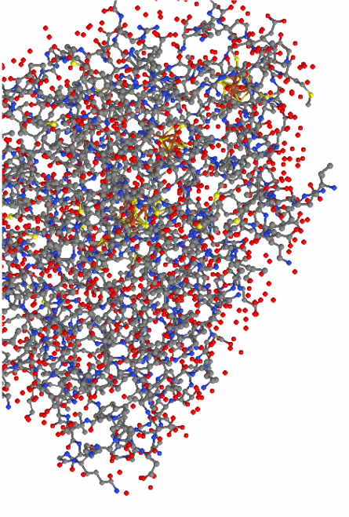
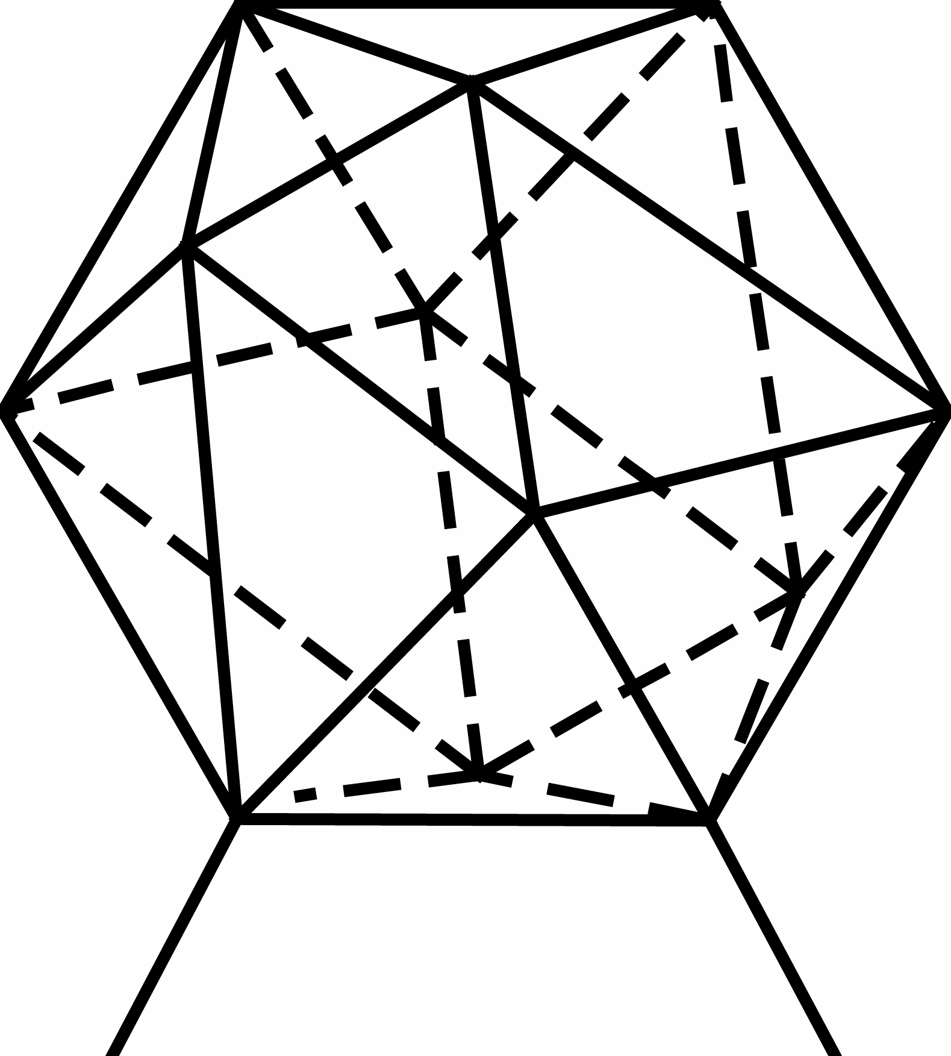
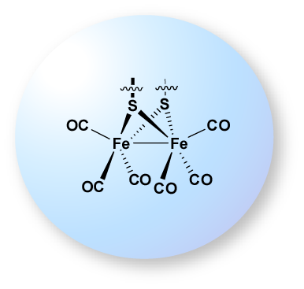
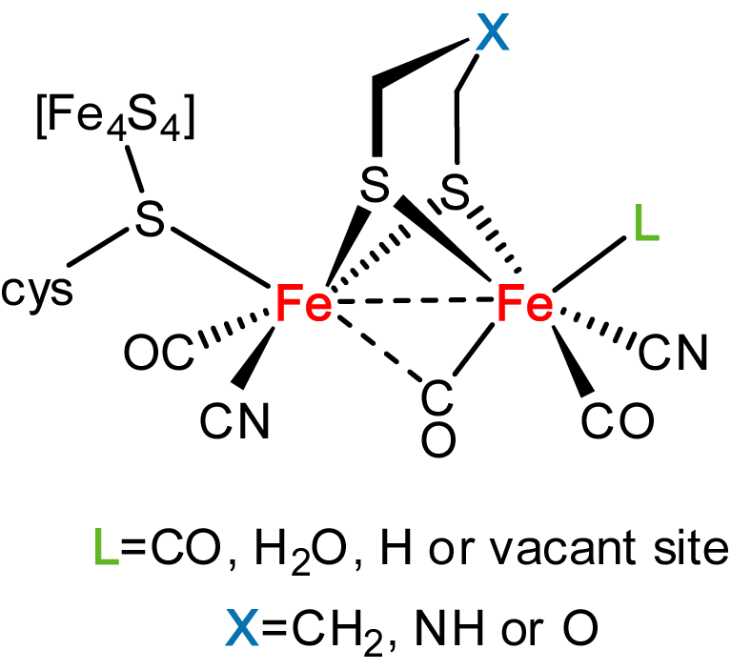

Diiron complexes with aromatic dithiolate ligands
quinoxaline
carborane
Aromatic dithiolate ligands
Tuning for catalysis at milder potentials
Notes:
..including excotic quinoxaline and carborande dithiolate ligands

Slide 61
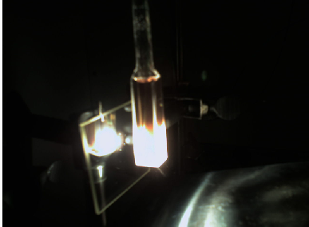
Bimolecular approach
Setup:
150 W halogen lamp as light source
455 nm long-pass filter + infrared filter
light power at sample (=after filtering) ~ 1 W
sample degassed and under Ar atmosphere
solvent:
H₂O:Acetonitrile 1:1 or
H₂O:Dimethylformamide 1:1
typical concentrations:
Ascorbic acid: 0.1M
Sensitizer: 140 μM
Catalyst: 14 μM
typical sample volume: 2.6 ml
H₂ detected
by gas chromatography
Components:
Ascorbic acid as proton and electron donor
Ruthenium(II)tris-bipyridine as photosensitizer
Diiron-(μ-Dichlorobenzene-dithiolate)hexacarbonyl catalyst
1
½ H₂
5
e⁻
2
e⁻
3
Ascorbic acid
Fe₂(μ-Cl₂-bdt)(CO)₆
Ru(bpy)₃²⁺
4
H⁺

Slide 62
An interesting development – complexes with only one Fe can also make hydrogen.
S
S
F
e
I
I
C
O
P
h
2
P
P
P
h
2
N
O
O
Hydrogen at low overpotential

Slide 63
Supramolecular chemistry
chemical LEGO
2
H O
2
+
4H
D
Link
S
A
Link
-
e
-
2
H
+
e
2
O
+
4H
2
Cobolt
light
Fe
Co(III)
oxide
N
Mn
Link
N
N
Ru
N
Mn
N
N

Slide 64
We have water oxididation catalyst Co-nanoparticle
We have many hydrogen forming catalysts Fe-complexes
We can drive them with light!
Can we combine them?

Slide 65
A ”Split-cell” for complete water oxidation/fuel formation
with catalysts of earth abundant elements from our laboratory
e-
e-
e-
e-
e-
O₂ + 4H⁺
4H⁺
e-
TiO₂
2 H₂O
2 H₂
NiO

Slide 66
H₂ by photosynthesis
Water as substrate
Organisms
in Bioreactors
Artificial
Systems
Soon
-will work
-explored by many

Slide 67
H₂ by photosynthesis
Water as substrate
Bioreactors
Artificial
Systems
Soon
-will work
-explored by many
Long term
- big potential
- more unproven

