Slide 1
Science-Policy-Dialogue at the Leopoldina
Henning Steinicke
Scientific officer in the Department Science-Policy-Society
Science-Policy-Workshop October 20 - 21 2011
Lisbon

Slide 2

History & development of the Academy
__
__

Slide 3
History & development of the Academy
since 2008 (3 years)
356 years

Slide 4
Department
Science-Policy-Society
-Tasks-
Scientific commissions
> Climate, Energy, Environment
> Life Science
> Health
> Ageing and Fertility
> Acceptance of Science
> Ethics in Science
> Science report
Member care
Working groups (examples)
> Energy
> Personalised Medicine
> Quantum technologies
> Integration
Adressed
audience
Leopoldina-Classes
> Class I: Mathematic, Natural- and Technical Sciences
> Class II: Bio Sciences / Life Sciences
> Class III: (Bio-)medical Sciences
> Class IV: Human, Cultural, Behavioural and Social Sciences
Leopoldina-Symposia
& Workshops

Slide 5
Types of statements
➔ Ad-hoc statements
➔ Statements & recommendations (~1 year working groups)
➔ Longterm projects

Slide 6
Finding a topic
From Academy members or Academy commissions
Request from policy
Rise of discussion in the society

Slide 7
Process
… from the idea to the product
Concept
Review (internal & external)
Discussion & writing
Presidium
Publication
Scientific administration & „accompaniment“

Slide 8
Arbeitsweise
Themenfindung

Slide 9
Arbeitsweise
Etablierung von AGs

Slide 10
Formats
 | Ad-hoc-Statement incl. "Executive Summary" | Statement and Recommendations incl. Executive Summary (comprehensible)
Function | Recommendations for specific, definable, current topics of high political / societal relevance | Extensive development of complex topics with recommendations
Contributors | Members of the Academy and external experts
Special characteristics | Function, target groups, and time frame vary depending on occasion, context, topic | Topic-oriented, less occasion-oriented; may be academical topic
 | 4-30 pages | 30-150 pages

Slide 11
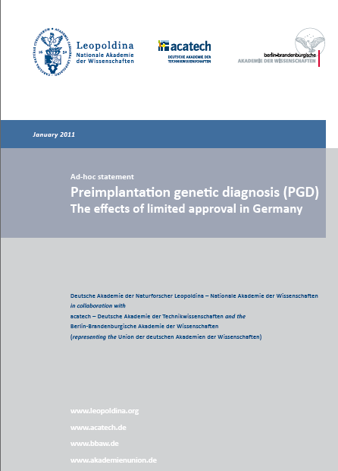
Preimplantation genetic diagnosis
Federal court decision
Renewal of the embryo protection law
Available online

Slide 12
Preimplantation genetic diag.
Emotional debate in society and parliament (lack of scientific background)
Ad hoc statement (~8 weeks)
11 scientists + 2 moderators (spokespersons of the "Ethics of Science" standing committee)
  Reproductive medicine, repro biology, and gyneacology
  Human genetics
  Developmental biology & general genetics
  Philosophy & ethics
  Legal sciences
6 reviewers

Slide 13
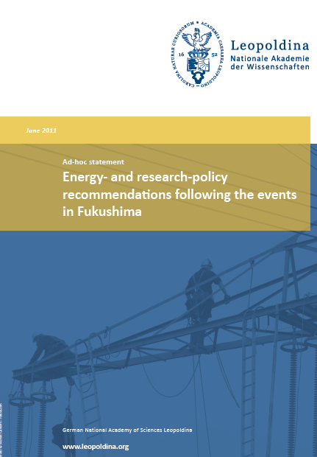
Energy
Fukushima
Ethics commission (Chancellor)
Request of ministry – scientific base
BM Schavan: "please, keep out the stakeholders"
Time frame → 3 months
Ad hoc statement
Available online

Slide 14
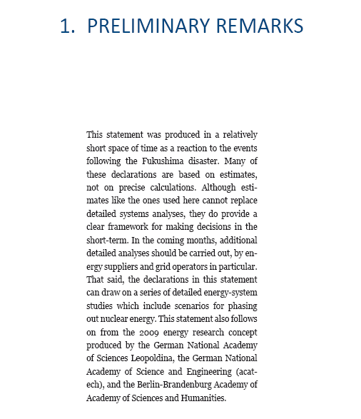

Slide 15
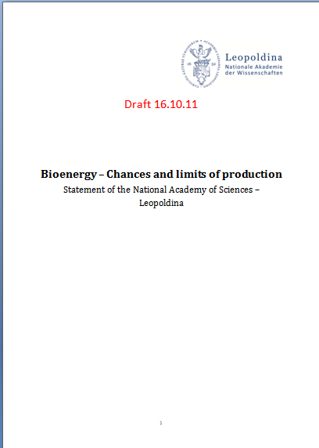
Bioenergy
Working group from within the academy
Starting workshop
Combination of three WG's (3 Chapters)
Time frame ~1 year
To be published

Slide 16



And many more…
(Integration, Quantum technologies, Nanotechnology, Taxonomy, Animal testing, Personalised medicine, Public health, Antibiotics, Future with children)

Slide 17
Results for Policy and Society
➔ Publication after review process
➔ Reports (printed & online)
➔ Presentations (e.g. parliamentary evening)
➔ PR
➔ Analysis of reception
e.g. Preimplantation genetic diagnosis 2011

Slide 18
Thank you… henning.steinicke@leopoldina.org; www.leopoldina.org

