Slide 1
EASAC science-policy dialogue project: phase 2 – 2011
Report of phone interviews with Academies
Gill Petrokofsky
20-21 October 2011, Academy of Lisbon

Slide 2
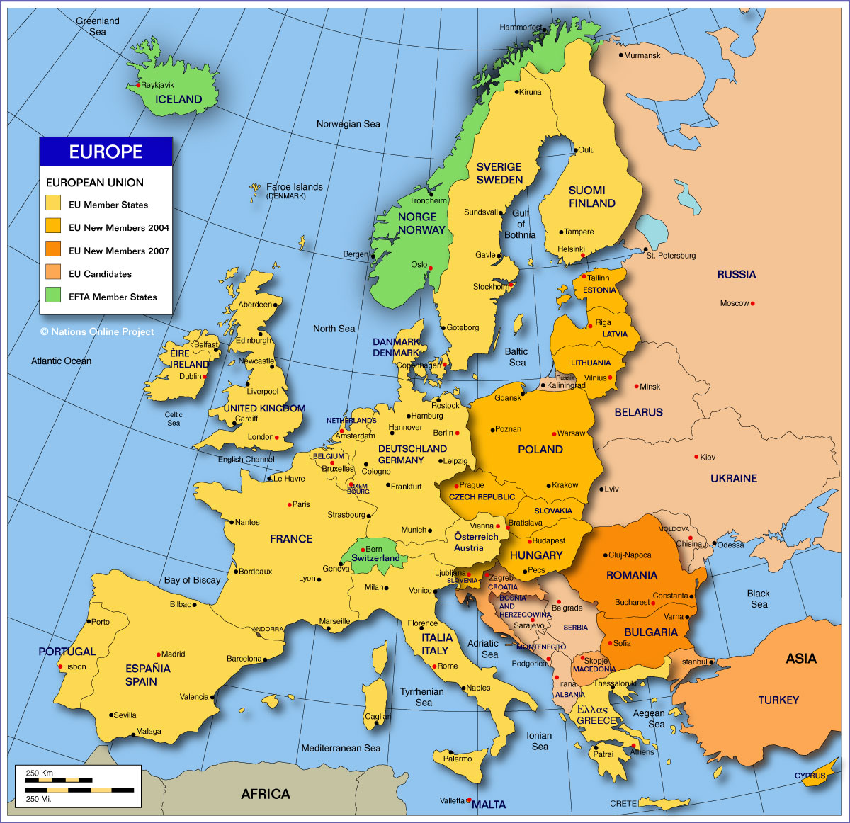
Participants
Phone interviews
Written responses
Austria
Belgium
Bulgaria
Czech Republic
Finland
France
Germany
Hungary
Ireland
Italy
Latvia
Netherlands
Norway
Portugal
Spain
Sweden
Switzerland FEAM
Estonia
Greece
Lithuania
UK

Slide 3
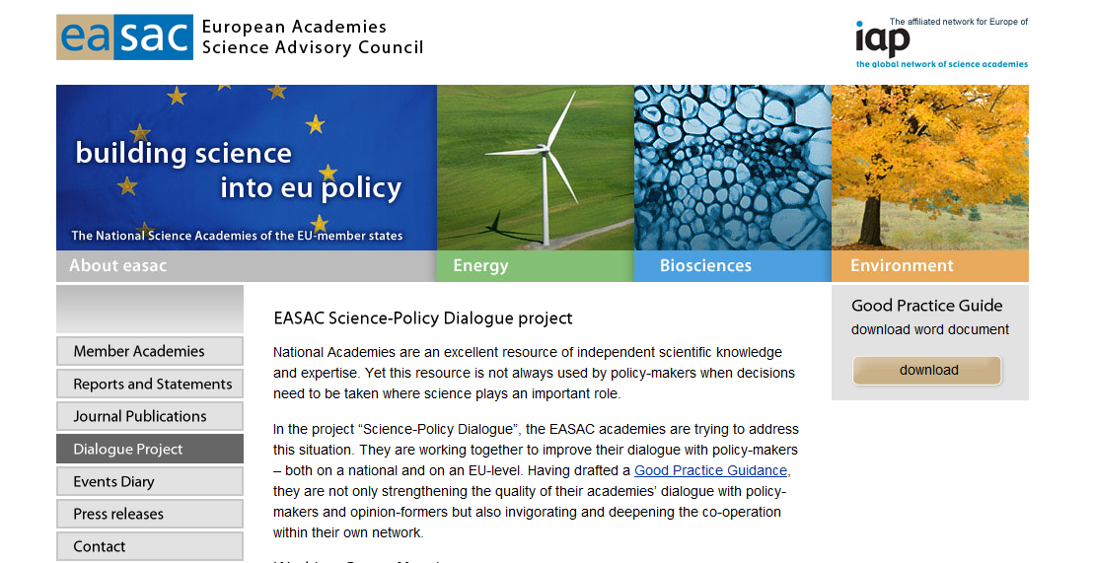
Good Practice Guide – feedback 1
Good Practice Guide: feedback 1
http://www.easac.eu/home/dialogue-project.html
Notes:
Few academies had received feedback on the Guidelines; those who had reported a very positive response. Active dissemination of the Guidelines had been limited (largely owing to extreme shortage of staff time amongst officers). Some very positive feedback from Ireland and Hungary.

Slide 4
Good Practice Guide: feedback 2
Increasing usability
Shorter version (in addition)
Ease of translation
Likelihood of being read
Clear, unambiguous language
access for non-English readers
Expanding content
Cultural context
of policy-making
of scientific advice
What works - examples
Communication strategies
Notes:
Some academies reported that a succinct version of the Guidelines written in very clear, unambiguous English would be useful – for ease of translation and wider dissemination. Some of the suggestions for entry into the policy cycle may not have taken account sufficiently of cultural differences between academies in different European countries.

Slide 5
Key issues for science-policy dialogue
Challenges of Procedure
Communication
Access to policy-makers
Involving stakeholders
If
How
When
Evaluating advice
Institutional challenges
Budget
Staff resources
Generating interest within Academy
Being heard and listened to by policy-makers
Notes:
Summary slide introducing next slides

Slide 6
Key issues - 1. Communication
Can we raise the impact of advice written by the Academy using the media more effectively?
Communication is not a priority for Academy scientists
Scientific publishing is prioritised & rewarded
Career incentives for policy engagement?
How to get messages out to Academy members
Raise profile of science early
Would better enquiry-based scientific education in schools help influence future generation of policy-makers?
Notes:
Scientific publishing is prioritised over communication to the public. Reward is through academic publications. Could there be incentives to achieve kudos through policy engagement? Introducing enquiry-based scientific education in schools to raise awareness of the importance of science could help influence future generation of policy-makers.
There is a real problem of getting messages out to Academy members. Policy advice written by the Academy has little impact. Communication is not prioritised.

Slide 7
Key issues – 2. Access to policy-makers
Essential in preparing for dialogue
“Contacts are born not made”
challenge is to ensure that Academy can break into policy networks and have influence
National AND International (role for EASAC)
Practical steps to build awareness (& contacts)
Policy briefs of science advice
Emailing of brief reports to policymakers
Targetted print copies of full reports
Notes:
It is essential to have regular dialogue with policy-makers. Using multi-disciplinary teams within academies taps into wider networks. Maintaining the network is time-consuming; contacts must be nurtured. The prestige of the Academy has a significant impact on the ability of the academy to infiltrate policy networks. Some respondents thought that the small size of their country/small number of universities in their country meant that personal contacts within the country were easier. Access to EU-level politicians was mostly through personal contacts. Those reporting mass-mailing approach were not positive about how effective this is.

Slide 8
Key issues – 3. Stakeholders
Do we - why?
When?
How often?
How?
Bias – reduced or increased?
Notes:
Academies had diametrically opposed views about when to involve stakeholders. Those who deliberately exclude public opinion at early stages do so because of concerns for bias and undue unscientific pressure. Those who engage with the public early or who have procedures for calls for evidence, do so because of concerns for bias through missing views. For those who embrace stakeholder contributions at any stage, there do not appear to be procedures for robust ways of weighing their contributions. (The concerns about bias are not matched by procedures that guard against it to any degree)

Slide 9
Key issues – 4. Evaluating advice
“Quality assurance provides confidence in the evidence gathering process;
Peer review provides expert evaluation of the evidence itself. Both are vital tools in ensuring that advice is robust and current.
All evidence should be subject to critical evaluation; however, this can take different forms and needs to be proportionate to the nature of the evidence and its use”
(UK, Government Chief Scientific Adviser’s Guidelines on the Use of Scientific and Engineering Advice in Policy Making, 2010)
almost universally reported challenge for Academies
Notes:
No academies reported a formal process for evaluating either the quality of the evidence they produce (except quality by provenance – from experts must be expert) or the effectiveness of the advice (expect using metrics such as web hits and number of media stories). There was a general view that following up advice was a ‘good thing’ and should be a higher priority.

Slide 10
Key issues – 5. Institutional challenges
“WE HAVE NO BUDGET”
Policy advice needs staff resources
“THEY ARE NOT INTERESTED”
advice to policymakers who are not interested in science
advice from Academicians who are not interested in policy
“ACADEMY IS INDEPENDENT”
scientific credibility & bias
engage younger Academicians
Balance learned body and policy advice
Notes:
How to set up a policy unit in an Academy
How to make it work with no money/resources
What experiences can assist with value-for-effort for newcomers?
Two suggestions of strategies that appear to be working well are being selective about issues, and communicating widely using dynamic website for all new reports and targeted hardcopies for policy-makers.
How to ensure that policy-oriented work of Academy is not isolated from learned body of Academy
There may be a problem of perception that a policy unit could have too much influence/power. This links with problems of communicating within the academies to academicians with little or no interest in policy matters.

Slide 11
EASAC role
“provides a means for the collective voice of European science to be heard”
Why EASAC?
Practical help
Build on high regard of reports
Engage with more EU scientists
Website resources for science-policy dialogue
EU timetable
Horizon scanning
Evidence-based policy
Shared expertise
Database of experts
Notes:
Suggest the website should contain practical examples of things that have worked well. With sufficient enthusiasm one could stimulate interest by highlighting an “academy of the month’, with short, positive stories of general interest. Of particular interest might be accounts of Academy advice that has been communicated successfully.
EASAC not well known amongst Academy members generally. Raising profile could encourage engagement in reports and policy work generally

Slide 12
Final reflections
Key points of unity
“… a trans-European grouping can be more effective than a body from a single country” (EASAC)
Scientific integrity
Independence of academy
Desire to have a stronger voice in shaping policy through scientific input
Adapting advice but recognising core principles of good practice

