Slide 1
NASAC: Network of African Science Academies
21 October2011
Prof. Robin Crewe
Ms. Jackie Olang

Slide 2
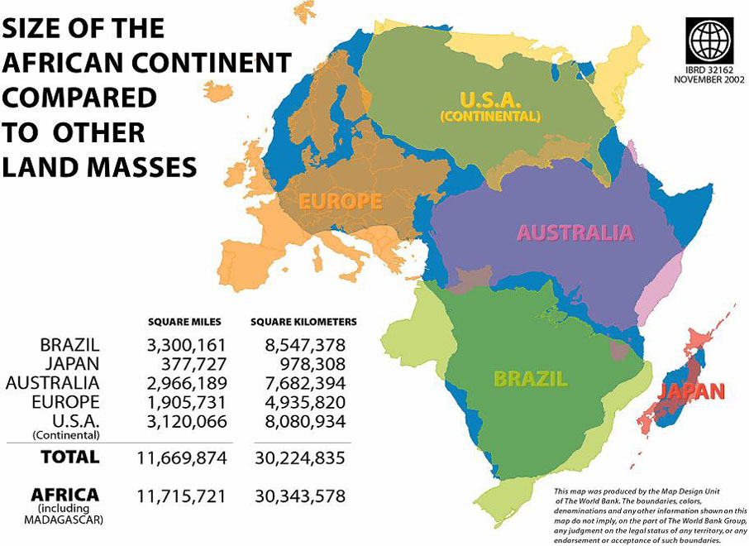

Slide 3
About NASAC: Mission & Members
Founded in Dec. 2001 as independent forum for African science academies to “provide authoritative science advise for policy formulation towards economic, social and cultural development in Africa”
17 member academies
Cameroon | Senegal
Ghana | Sudan
Kenya | South Africa
Mauritius | Tanzania
Madagascar | Uganda
Morocco | Zambia
Mozambique | Zimbabwe
Nigeria | Ethiopia
AAS (regional academy)
Potential members
Rwanda | Namibia
Egypt | Sierra Leone

Slide 4
Our Governance Structure
GENERAL ASSEMBLY
(Presidents or their Representatives from all member academies)
EXECUTIVE COMMITTEE
(President, 3 Vice Presidents, Treasurer & Secretary General)
AD HOC
COMMITTEES
STANDING
COMMITTEES
NASAC
SECRETARIAT
(Coordinator, Programme officers/assistants)
EXECUTIVE OFFICIALS
(From all member academies)

Slide 5
NASAC: What we do
NASAC
Facilitating Establishment Science Academies
Voice of Science in Africa
Strengthen
Existing
Academies
Independent platform for credible advise

Slide 6
Key successes (2001-to date)
Launching critical flagship programmes
Water
Energy
Women in Science
Science education
Creation of independent advisory groups
Expert Group
Ad hoc Committees (water, OC)

Slide 7
Key successes (2001-to date)
Increased NASAC membership – 8 -> 17
Capacity Enhancement
Programme Officers training
- Secretariat infrastructural support
- Governance meetings
Challenges + Opportunities = priorities

Slide 8
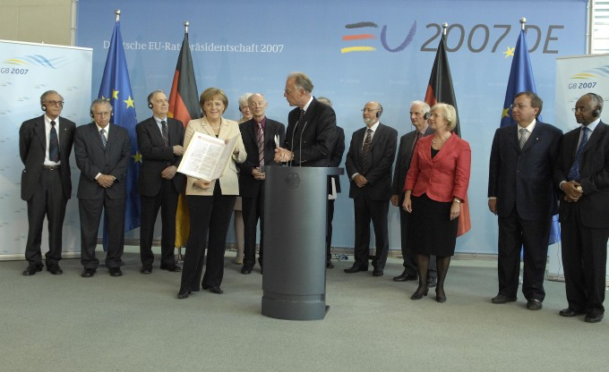
Key successes (2001-to date)
Provided simple succinct messages – through issuance of statements - being the voice of scientists
Participated in local and international fora – articulate our contribution
Sought networking opportunities – acting locally thinking globally
Interacted with policy and decision makers – enactment of science/scientist-friendly policies
Notes:
NASAC has also been invited by science academies in the G8 countries to issue statements to be released, together with statements of G8 academies, at G8 summits.

Slide 9
International Strategic Partners
IAP
Capacity Building
Science Edu.
ASADI
Partners
RS/Pfizer
Mentoring
Institutional support
Dutch Ministry/KNAW
Secretariat Support
Annual Conferences
Water Prog.
Increased membership
Training
Leopoldina
Expert working groups
Capacity building
NASAC Membership

Slide 10
Strategic Initiatives 2011-2015
Research and Development– Independent platform for collaborative work
Increased Membership – Ensure that NASAC grows as an institution by strengthening its membership
Enhanced Visibility –To use available media including social networking sites (as applicable) to communicate with stakeholders and with its members
Capacity Building - Strengthen member academies and develop their advisory capacity
Science Advocacy and Public Policy -Ensure unified voice for African academies in science, technology and innovation, and engage at the level of AU structures

Slide 11
EASAC-NASAC Collaboration
Sharing of guidance documents and experiences
Establishing a common understanding of the advisory role of academies
Establish inter-regional initiatives
Pairing of European academies with linguistically related African academies
EU focus on Africa to include development of Academy functions

Slide 12
Counting on your support…

